Slide 1
Classification of Beatles Songs through Audio and Lyrical Feature Analysis

Slide 2
Motivation
Why classify Beatles songs?

Slide 3
You know the reason The Beatles made it so big? 'I Wanna Hold Your Hand.' First single. Fucking brilliant. Perhaps the most fucking brilliant song ever written. Because they nailed it. That's what everyone wants.
- David Levithan, Nick & Norah’s Infinite Playlist

Slide 4
The Beatles have accomplished what no other band had before.
In addition to holding the No. 1 USA single with “Can’t Buy Me Love”, the Beatles also held the No. 2 slot and the No. 3 slot. In fact, Beatles songs occupied the top five positions on the charts.
Notes:
In addition to holding the No. 1 USA single with “Can’t Buy Me Love”, the Beatles also held the No. 2 slot and the No. 3 slot. In fact, Beatles songs occupied the top five positions on the charts.

Slide 5
What exactly fueled the Beatles’ meteoric rise to fame? Is there an intrinsic quality in their music that predisposes it to greatness?

Slide 6
This project
Classification of songs as either written by the Beatles or not
Identification of which features best differentiate the Beatles from other artists

Slide 7
Initial Approaches
Failed project ideas :)

Slide 8
Other attempted ideas
Classification of Billie Eilish songs
Only ~32 songs released by Billie Eilish from 2016-2021. Classifiers reported 99.99%+ accuracy without actually classifying any songs as Billie Eilish.
Classification and Regression of Song Popularity
Using audio features alone did not produce ideal results—regression outputted negative R² values and classification did not perform much better than random guessing.
Time Series Analysis of Song Popularity
Performing the same regression task using data from 2019 to predict popularity in 2020 did not output promising results, nor did using data from 2020 to predict popularity in 2021.

Slide 9
Related Work

Slide 10
Previous work has looked at…
Genre classification of songs using audio and lyrical features
Classification of primary authorship within The Beatles using lyrical features
Prediction of hit songs using both lyrics-based and audio-based features

Slide 11
Implementation

Slide 12
General Roadmap
Data collection
Exploratory Data Analysis
Feature Analysis
1
3
5
2
4
6
Data cleaning and preprocessing
Classification Analysis
Final Results!

Slide 13
Data collection
Audio-based features
Audio-based features were taken from a dataset on Kaggle containing song data of all songs released on Spotify from the years 1922-2021. Audio features were generalized characteristics about the song, such as energy and loudness.
Lyrics-based features
Lyrical-based features were scraped from the genius.com website using the LyricsGenius API for Python. After retrieving the full lyrics for each song, we then performed preprocessing.

Slide 14
Data Preprocessing of Lyrical Data
Convert all strings to lowercase and remove punctuation.
Tokenize lyrics.
Remove stop words and all one-letter words.
Lemmatize remaining words.
Convert to bag-of-words format.
Variance threshold feature selection

Slide 15
Cleaning of Audio Features
Create additional target column taking value 1 for if song was written by The Beatles, 0 if not.
Create separate dataframe of just non-Beatles songs to trim down training set
Drop all songs released outside of 1962-1970.
Drop all songs with popularity outside of range 20-70.

Slide 16
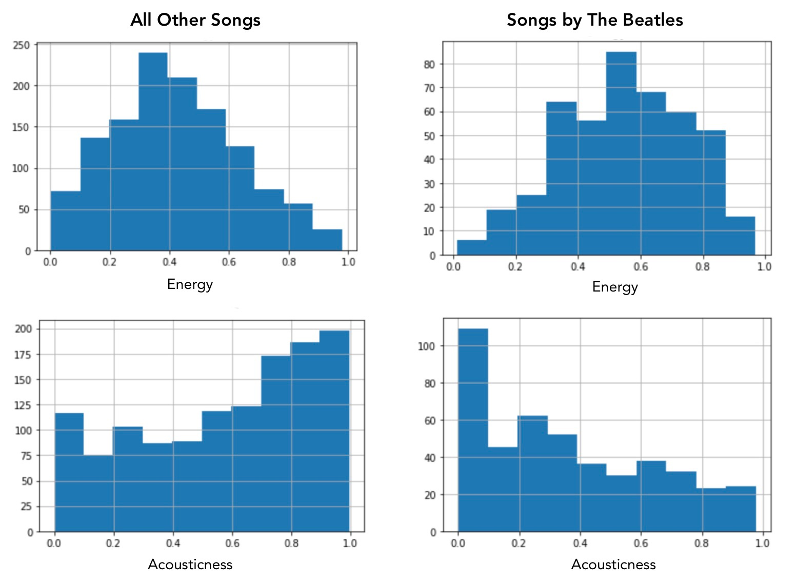
Exploratory Data Analysis

Slide 17
Classification Analysis
Written by The Beatles
(Class 1)
Songs
Trained Classification Model
Not written by The Beatles (Class 0)

Slide 18
Results

Slide 19
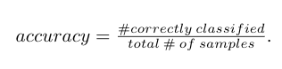
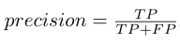
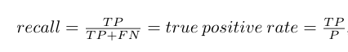
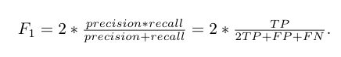
How to evaluate?
Metrics: accuracy, precision, recall, F₁
Receiver Operating Characteristic (ROC) Curves and Area Under Curve (AUC)
Most important? Accuracy and recall

Slide 20
Classification Results
Logistic Regression
Accuracy: 91.9%
Recall: 79.8%
Naïve Bayes
Accuracy: 82.6%
Recall: 55.3%
241
9
232
18
0
0
Actual Label
Actual Label
19
75
42
52
1
1
0
1
0
1
Predicted Label
Predicted Label

Slide 21
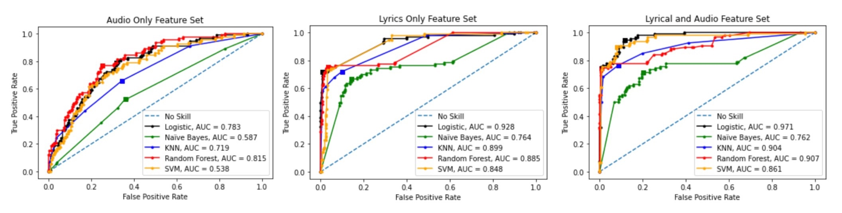
Classification Results
Receiver Operating Characteristic Curves for Classifiers across Feature Sets

Slide 22
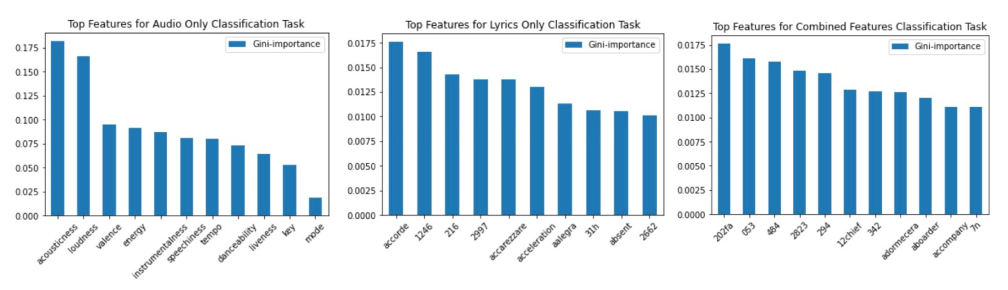
Feature Analysis Results
Top Most Important Features for Classification across Feature Sets

Slide 23
Overall Conclusions
Lyrical-based features are generally more predictive of authorship than audio-based features
A combination of lyrical and audio features produced the best classification results
Of audio features, songs by The Beatles were generally less acoustic and more energetic than other songs.

Slide 24

Thanks!
Any questions?

